Slide 1
Oracle Cloud DBA
Lear how to stay up to date on this Dbaas era – Day 1
Marcel Lamarca
Exadata Cloud Specialist
Oracle, Alliances and Channels LAD
February, 2024

Slide 2




SQL> select * from person where name = ‘Marcel Lamarca’
About My Career
22 Years dedicated to study and support Oracle Databases.
12 Years working with Exadata (On-prem, C@C and Cloud Services) .
5 Year working for Oracle do Brasil
2 Year on Alliances LAD knowledge Team
Certifications
Oracle Cloud Specialist (OCS)
Exadata Database Machine X9M Certified Specialist
OCI Foundation 2020 / 2023
Oracle Autonomous Database professional Administrator 2019 / 2023
Oracle Cloud Database Migration and Integration 2021
OCI Cloud Certified Architect Associate 2022
OCI Cloud Certified Architect Professional 2022
OCI Multi-Cloud Architect Professional 2023
Oracle Database Services Certified Professional 2023
Oracle Certified Professional (OCP)
Oracle Database certified professional 10g, 11g, 12c and 19c.
Mysql 8.0 Database Administrator Certified Professional
Oracle Certified Specialist (OCE)
Grid/RAC Database Administrator 11g
Oracle Golden Gate 12c Certified Implementation Specialist
MARCEL LAMARCA
Exadata Cloud Specialist
Upgrade, Utilities, Patching, Performance & Migrations
marcel-lamarca
marcel.lamarca@oracle.com

Slide 3


Agenda
1
Oracle Exadata Cloud
2
OCI Backup Database Options
3
Oracle NoSQL Database Cloud Service
4
Resources

Slide 4
OCI Cloud Region Maps

Slide 5


Oracle Cloud Infrastructure Global Footprint
Amsterdam
Stockholm
Montreal
Frankfurt
NEW
London
Toronto
Israel 2
Mumbai
Zurich
Israel 2
Dubai
Chicago
Newport
Serbia
Saudi Arabia 2
Hyderabad
Chuncheon
NEW
Madrid
Jerusalem
Milan
Saudi Arabia 3
San Jose
Paris
Marseille
Ashburn
NEW
Kenya
Abu Dhabi
Phoenix
Vinhedo
Jeddah
Seoul
Singapore 2
Tokyo
Singapore
Bogotá
São Paulo
Osaka
Johannesburg
Queretaro
Santiago
NEW
Monterrey
Valparaíso
Melbourne
Sydney
February 2024
48 regions; 5 more planned
12 Azure Interconnect Regions
Canberra
NEW
Commercial
Commercial Planned
Sovereign
Government
Microsoft Interconnect Azure

Slide 6
Oracle Database deploy options

Slide 7


Choice of control and hybrid strategies
Use a single database for all deployments
Autonomous Database
Serverless
Autonomous Database Dedicated
Exadata Cloud@ Customer
Oracle Database Service on OCI Compute (BM/VM)
Database Cloud Service
(on BM/VM)
Exadata Cloud Service
Oracle Exadata On-Premises
Commodity HW, On-site
Fully automated data management with no human intervention
Fully automated, isolated data management with control
Database control, sovereignty, privacy req. of mission critical workloads managed by Oracle
Customer deployed and managed DB Workloads on OCI compute
DB Workloads running on BM/VM in public cloud
High performance DB workloads on Exadata in public cloud
For sensitive data with higher availability, perf needs
Customer- managed workloads running on commodity h/w

Slide 8
Oracle Exadata Cloud

Slide 9




Exadata runs everywhere
Identicality across deployments improves IT agility and reduces costs
On-premises
Exadata Database Machine
Public Cloud
Exadata in Oracle Cloud Infrastructure (OCI)
Hybrid Cloud
Exadata Cloud@Customer
Multicloud
Exadata through Oracle Database Service for Azure

Slide 10
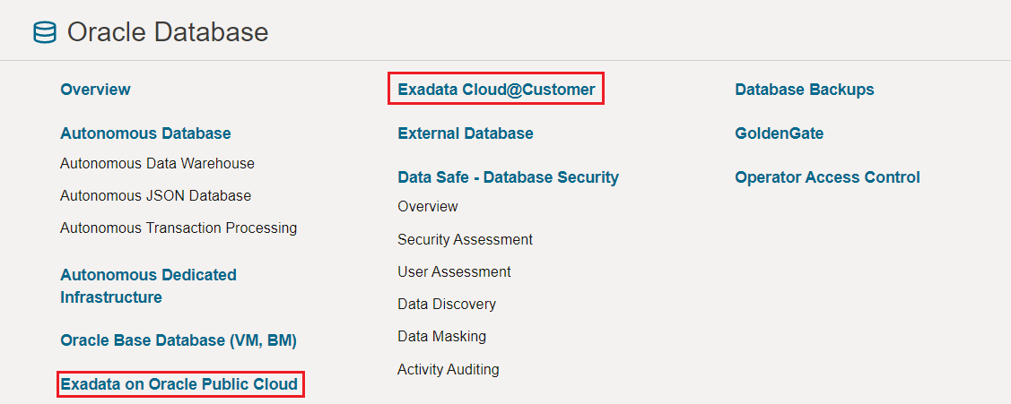
Exadata Cloud | OCI Console

Slide 11
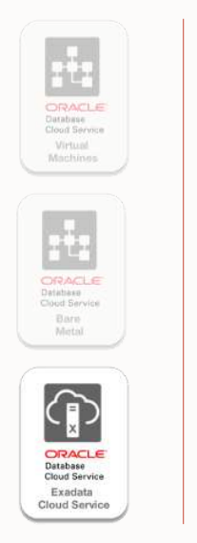
Database Cloud Service | Exadata Understanding Oracle Exadata Cloud Service and Cloud at Customer
World’s Best database machine, provisioning with GI
• As many databases as you want
• No Single Instance allowed. Just RAC!
• Start With 2 cores and Scale Up/Down OCPU’s based on your requirement
• Data Guard with and across Ads
• Only Oracle Database Enterprise Editions allowed
• Works with Autonomous Database on Dedicated Infrastructure

Slide 12
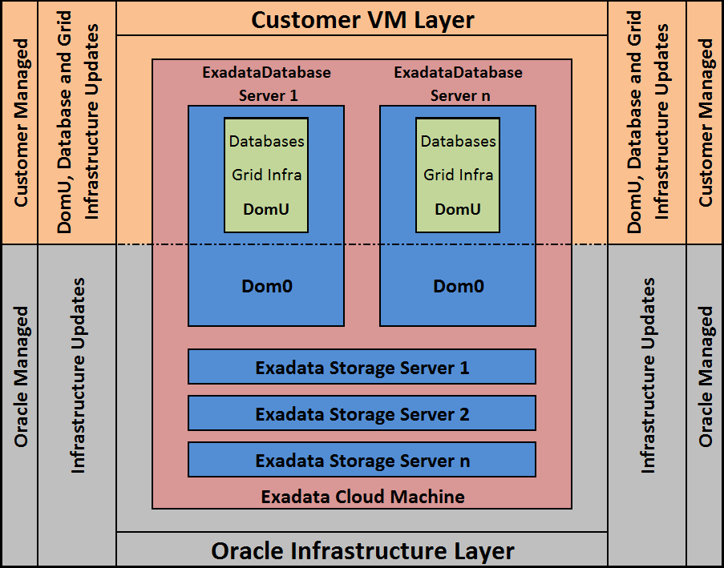
Exadata Cloud | Dom0 vs DomU Roles and Responsabilities
About Dom0 Oracle Responsibilities
Oracle Cloud Ops manage Exadata infrastructure (hardware, system software) & hypervisor (dom0);
Oracle Support is responsible for update any version;
The customer is responsible for scheduling Dom0 maintenance and must provide at least 4 dates per year;
About DomU Customer Responsabilities
Adjust license (BYOL or License included)
Scale UP/Down resources
For Exadatada Cloud at Customer Gen2 DomU uses KVM
Customer have root access to domU;
The customer is responsible for any update or configuration change on DomU;

Slide 13
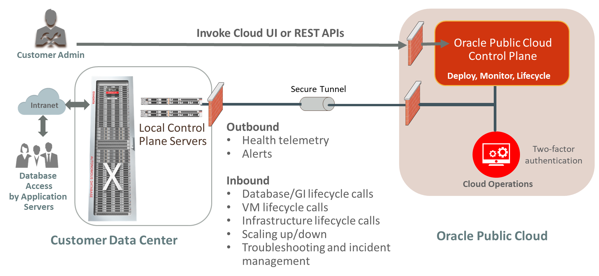
Exadata Cloud at Customer | Control Plane Workflow

Slide 14

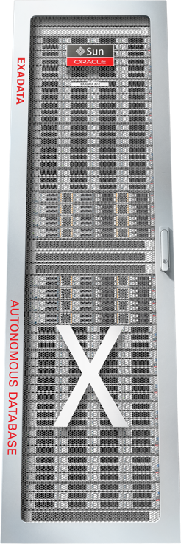


Exadata Cloud Service Architecture
Invoke Cloud UI
REST APIs via https
Cloud API Access
Database Access
Integration with OCI Services
Customer Tenancy
Customer Auditing and Access Controls
Customer Admin
Database/ExaCS
Lifecycle Management
OCI Fast Connect
(Optional)
Customer Client/Backup VCN
Service Management VCN
Cust
VM
Oracle Service Tenancy
Oracle
Auditing and Access Controls
Automation Delivery
Infrastructure Maintenance
Oracle Admin VCN
Database
Access
Application
Servers
Oracle Operator SSH
Oracle Admin VCN
Customer Data Center
(Optional)
Multi-Factor Authentication
Oracle
Cloud Ops
Oracle Cloud Infrastructure Region

Slide 15
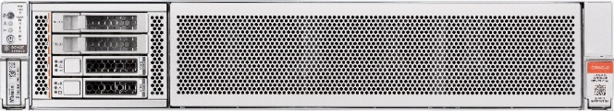
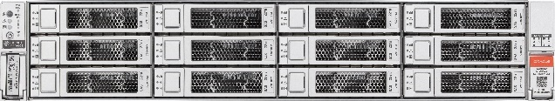


Exadata architecture – scale out with intelligent storage
Database Servers
Scale-out system architecture and software
Independent, online scaling of database and storage servers
Scales from 2 to 210 Exadata X10M database servers
Scales from 3 to 264 Exadata X10M storage servers
Redundancy with fast failover provides high availability
Database uses RDMA instead of I/O to read XRMEM in Smart Storage
Bypasses network and I/O software, interrupts, context switches
Data is transparently managed in multiple storage tiers to minimize latency
High-performance active-active 100 Gbit/s internal network maximize throughput
Speeds up both database reads and commits
Database cluster virtualization
Deploy environments with different needs on the same system
Dev-Test, Staging Production, DR
OLTP, Analytics, Mixed Workloads
Share and manage pools of resources to increase efficiency and lower costs
Isolate resources to meet differing security and predictability requirements
RoCE
RDMA
Storage Servers
Hot
XRMEM
Warm
FLASH
Cold

Slide 16

There are no EF and XT Storage options for Exadata Cloud
High-Capacvity (HC) Storage
Extreme Flash (EF) Storage
Extended (XT) Storage
Database Servers
Database Servers
Database Servers
RoCE
RoCE
RoCE
RDMA
RDMA
RDMA
Storage Servers
Storage Servers
Storage Servers
Hot
XRMEM
Hot
XRMEM
Cold
Warm
FLASH
Warm
FLASH
FLASH
Cold
FLASH

Slide 17
Exadata Cloud X9M Flexible Shapes
Available in high-performance, cost-effective shapes to match enterprise needs
X9M Full Rack
Ideal for large-scale consolidation for all type of database workloads
8 Database Servers
12 Storage Servers
Max VM’s per DB 16
18 TB PMEM
X9M Half Rack
Ideal for very large databases and medium-scale consolidation
4 Database Servers
6 Storage Servers
Max VM’s Per DB 16
9.0 TB PMEM
X9M Quarter Rack
Ideal for large databases, small-scale consolidation, and petabyte-scale analytics
2 Database Servers
3 Storage Servers
Max VM’s Per DB 8
4.5 TB PMEM
Storage
Base System
Ideal for small-scale consolidation and the lowest cost
2 Database Servers
3 Strorage Servers
Max VM’s Per DB 4
No PMEM
Compute

Slide 18
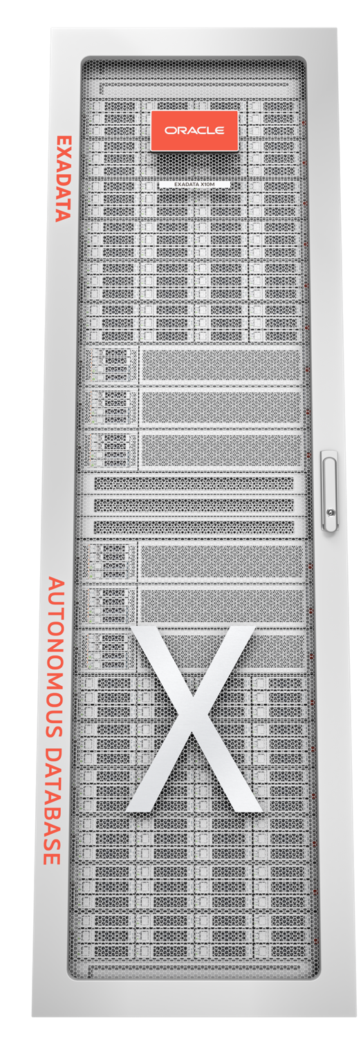
Exadata Cloud at Customer X10M Shapes
NEW SHAPE
NEW SHAPE
Quarter Rack – X10M
380 Cores – 2,780 GB Memory
192 TB Usable DB Storage
Quarter Rack – X10M - L
380 Cores – 4,180 GB Memory
192 TB Usable DB Storage
Quarter Rack X10M-XL
380 Cores – 5,600 GB Memory
192 TB Usable DB Storage
Total Capacity
DB Servers
Storage Servers
There are no Half and Full rack shapes.
Expand Quarter Racks using Expansion Servers.

Slide 19





























Easily right-size your service by adding compute and storage as needed
Consolidate up to thousands of databases
OLTP
Converged database, private cloud in the public cloud
Compute scaling
Add compute servers
OLTP and data warehouse
Starter Configuration
Petabyte data warehouse
Add storage server(s)
Storage scaling
Online – No downtime scaling

Slide 20
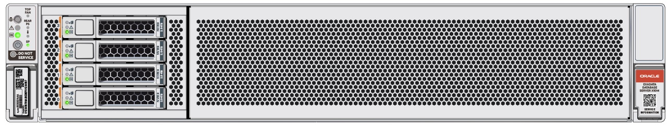
Exadata Cloud@Customer X10M Shapes
All Configurations greater than a Quarter Rack are elastic
Standard Configuration
Elastic Configuration
Incrementally add Database and Storage Servers
Add Racks to Continue Scaling
Primary
Rack
Expansion
Rack(s)
Database
Server
Database
Server
Storage
Server
Storage
Server
Start with a Standard Configuration
Quarter Rack
Quarter Rack-L
Quarter Rack – XL
Elastically Expand Rack with Servers
Database Server
Storage Server
Can NOT mix Database Servers with different memory configurations
e.g. X10M cannot be mixed with X10M-XL
Continue to Expand Servers using Expansion Rack(s)
Up to 6 Racks including primary rack
Max 32 Database Servers
Max 64 Storage Servers
Max 5 Expansion Racks

Slide 21
Exadata Cloud tools

Slide 22
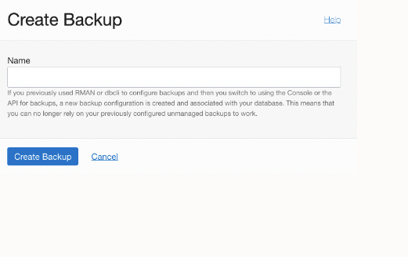
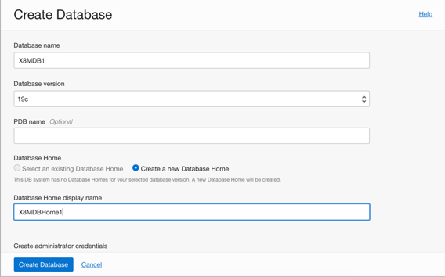
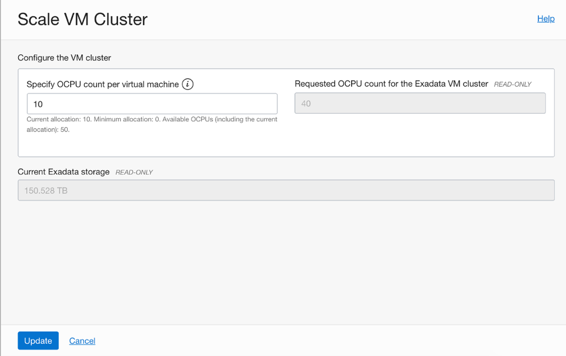
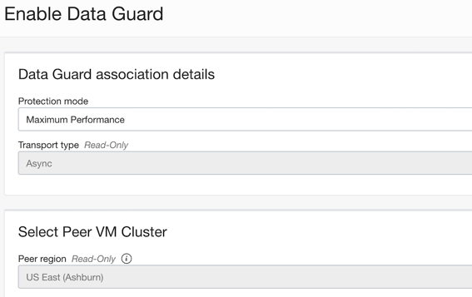
Cloud Automation for Common Lifecycle Tasks
Oracle Cloud Web base UI, REST APIs, SDK, CLI, Terraform
Scale OCPUs
Create Database Homes and Databases
Schedule Infrastructure Maintenance
Update Operating System, Grid Infrastructure, and Databases
Backup and recovery
Enable Data Guard

Slide 23


Exadata Cloud Command Line Interface (dbaascli)
How to upgrade DBAAS Cloud Tooling using dbaascli (Doc ID 2350471.1)
Database Commands
dbaascli database create
dbaascli pdb create
dbaascli pdb relocate
Backup Commands
dbaascli database backup
dbaascli database recover
dbaascli create-dbstorage
Database Home Patch
dbaascli database upgrade
dbaascli db home patch
dbaascli grid patch
dbaascli update-dbhome

Slide 24
Exadata Cloud Pathing

Slide 25
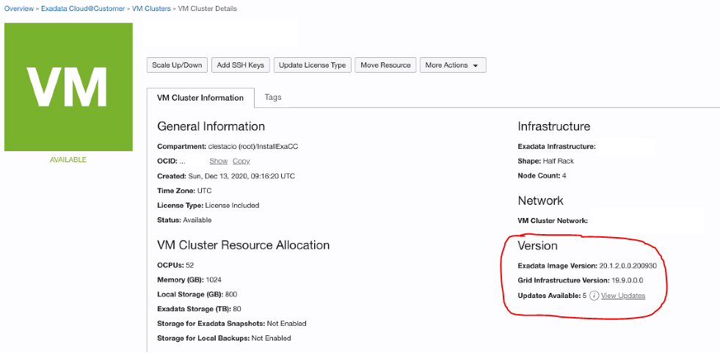
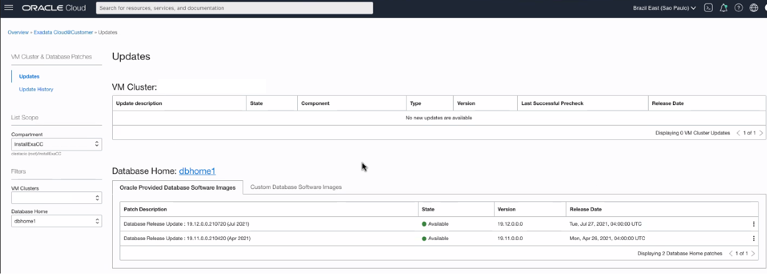
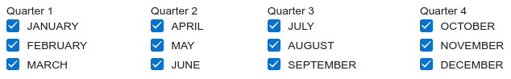
Exadata Cloud Pathing Pathing dom0, domU, Tooling, Grid and Oracle home, how and how to do
DOMU - CUSTOMER RESPONSIBILITY
DOM0 - ORACLE RESPONSIBILITY
Maintaining a secure Exadata Service instance in the best working order requires you to perform the following tasks regularly:
- Patching Grid Infrastructure.
- Patching Database software.
- Patching Exadata Software Image (SO).
- Patching Tooling (dbaascli).
- Patching other components installed on DomU.
Oracle manages quarterly infrastructure maintenance updates of all other infrastructure components:
- Patching Database Servers (Dom0).
- Patching Storage servers.
- Patching Network switches.
- Patching Control Planes.
Quarterly maintenance updates may require a restart of the customer-managed guest virtual servers.

Slide 26
Exadata Cloud Features

Slide 27
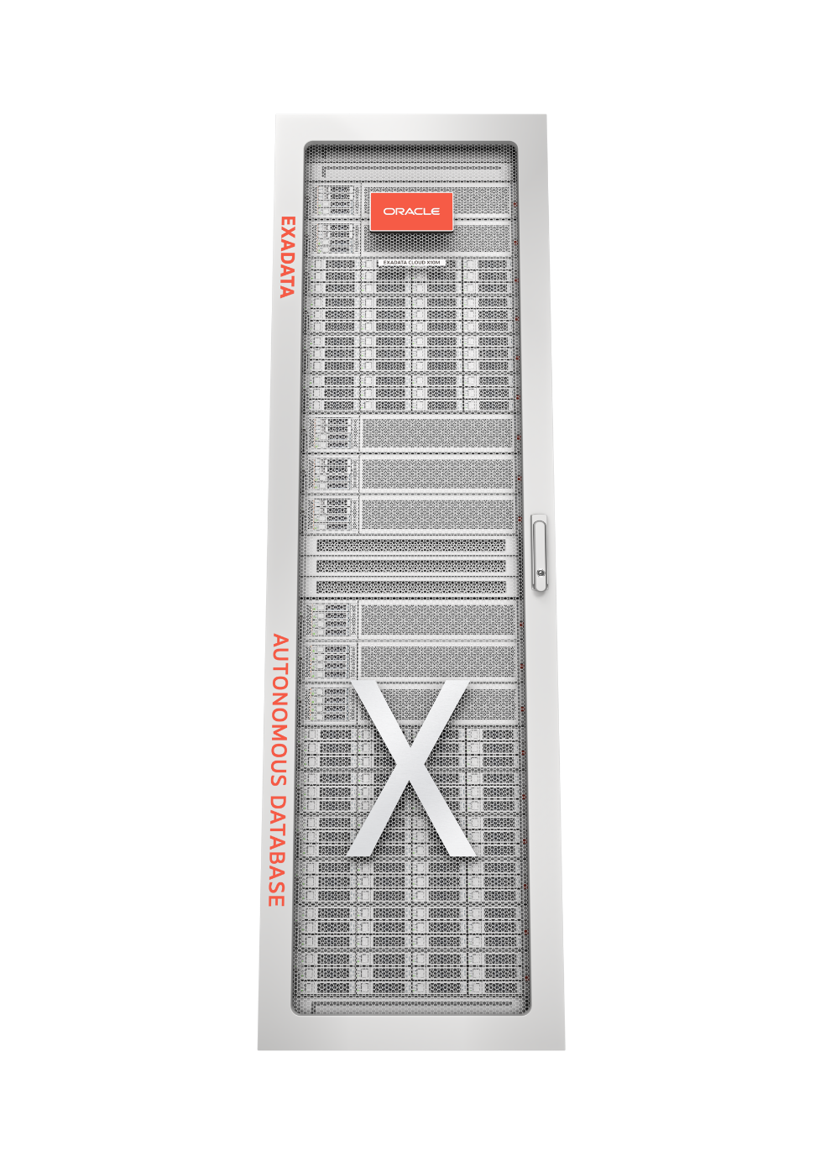
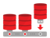


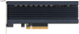


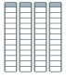
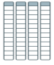




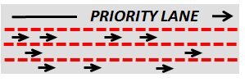



Oracle Database and Exadata Platform Innovations
Offload SQL to Storage
Multitenant
RoCE Fabric
In-Memory DB
100 Gbps
XRMEM Data Accelerator
Real Application Clusters
Smart Flash Cache
PCI Flash
Active Data Guard
All Oracle Database Innovations
All Exadata
DB Machine Innovations
Storage Indexes
Partitioning
Columnar Flash Cache
Advanced
Compression
Hybrid Columnar
Compression
HCC
Advanced Security, Label Security, DB Vault
10:1
I/O Resource Management
I/O
I/O
I/O
Real Application Testing
Network Resource Management
Advanced Analytics, Spatial and Graph
In-Memory Fault Tolerance
Management Packs for Oracle Database
Exafusion Direct-to-Wire Protocol

Slide 28
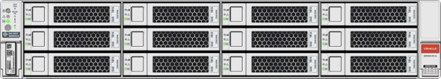
Fastest Cloud In Memory, Smart Scan and HCC
Unique: Smart Scan (SQL Offload)
Data-intensive processing* runs in Exadata Storage, bypassing network bottlenecks and freeing up DB CPUs
Unique: Tiered Flash Cache
Active data is automatically cached on PCI NVMe Flash, inactive data on low cost, high-capacity disks
Unique: Storage Indexes
Eliminates I/O not relevant to a particular query
Unique: Hybrid Columnar Compression (HCC)
Compressed, columnar format in storage, saving space, reducing I/O, speeding analytic queries
Unique: In-Memory Columnar (IMC)
Extends In-Memory database performance to higher capacity Flash memory in storage
Exadata
Database Cluster
SQL Offload
100g RoCE Network
Storage Index (DRAM)
Storage Index (DRAM)
PMEM Accelerator
Storage Index (DRAM)
PMEM Accelerator
PCI NVMe Flash
IMC
PMem Accelerator
PCI NVMe Flash
PCI NVMe Flash
HCC
Exadata
Storage Server
10:1 Compression
*Includes long-running SQL queries, backups, decryption, aggregation, data mining

Slide 29
Smart Scan

Slide 30
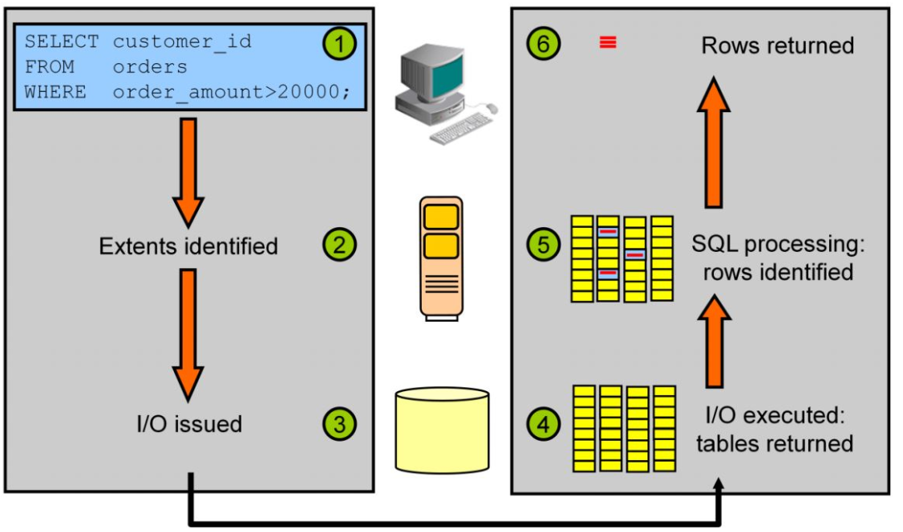
Oracle Database | No Exadata System

Slide 31
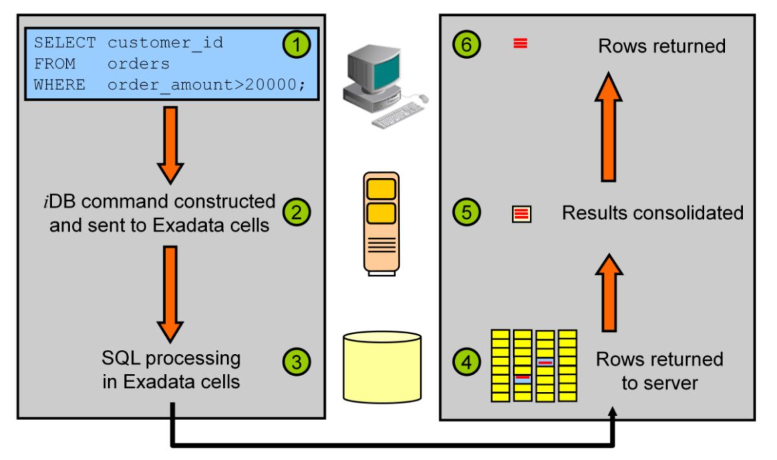
Exadata Cloud a Smart Scan | Off Load Querying

Slide 32
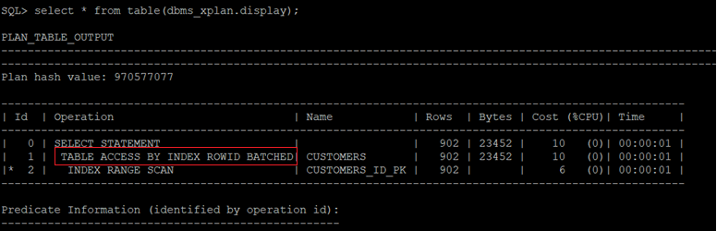
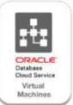
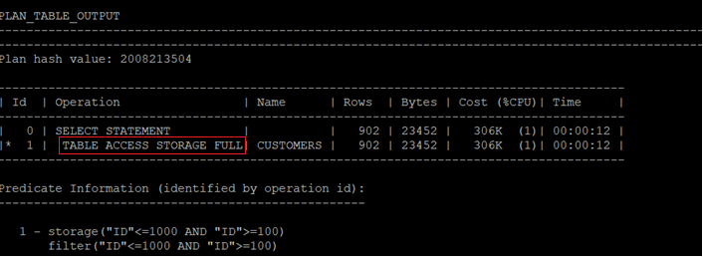
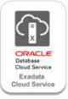
Query Execution plan | Traditional Database Vs Exadata System

Slide 33

Exadata Smart Scan Why it’s not working?
Scan performed on clustered table
A Scan is performed on an index-organized table
Fast full scan is performed on a compressed index
Fast full scan is performed on a reverse key index
The table has row-level dependency tracking enabled.
The optimizer wants the scan to return rows in ROWID order
A LOB or LONG column is being selected or queried
A select version flashback query is being executed
A query that has more than 255 columns is referenced

Slide 34
Oracle Database backup options

Slide 35
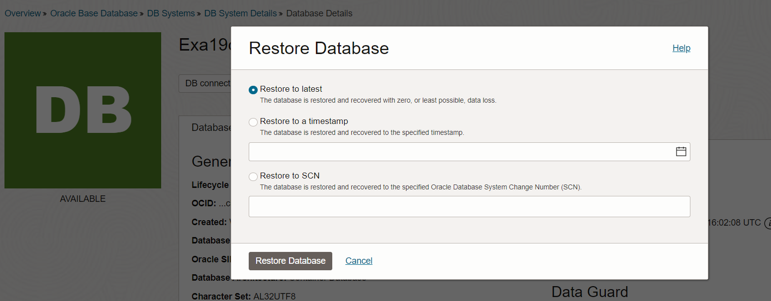
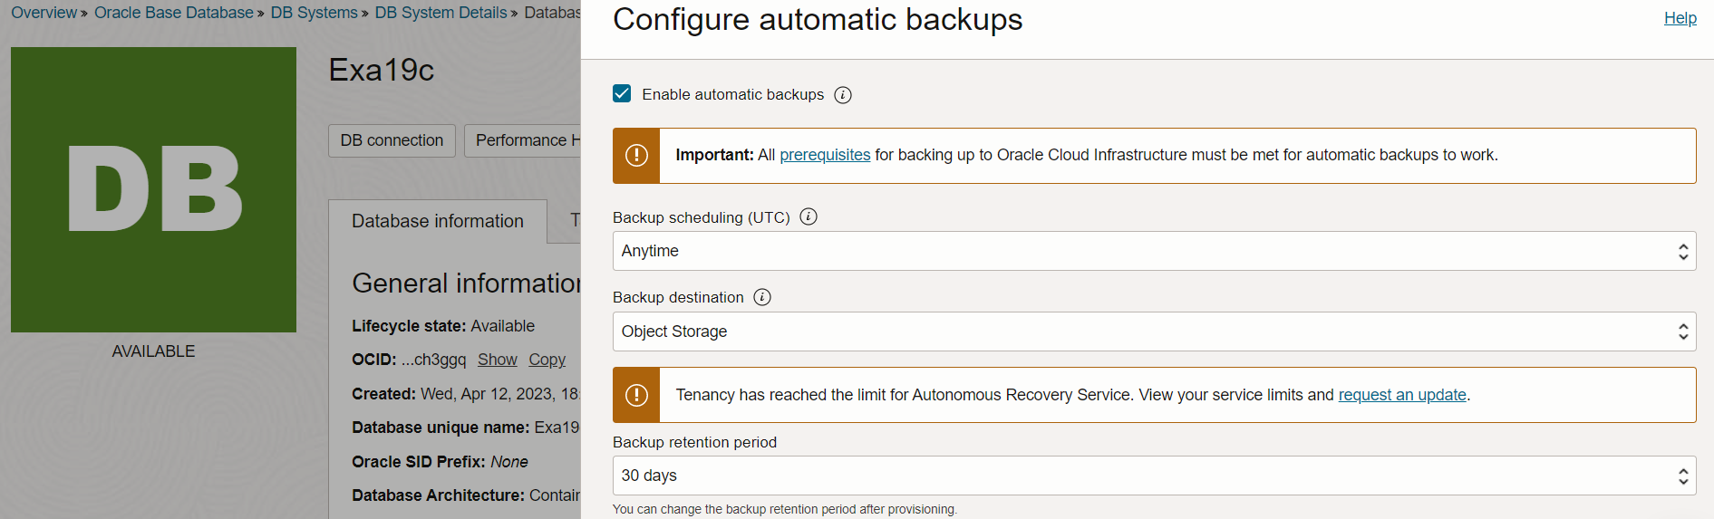
Oracle Database automatic backup
Manage backup and restore feature for VM/BM DB System
• Backup stored in Object or Local storage
• DB System in private subnets can leverage Service Gateway
• Start With 2 cores and Scale Up/Down OCPU’s based on your requirement
Backup Options
• It is not possible to create a non-CDB via the console - use dbcli

Slide 36
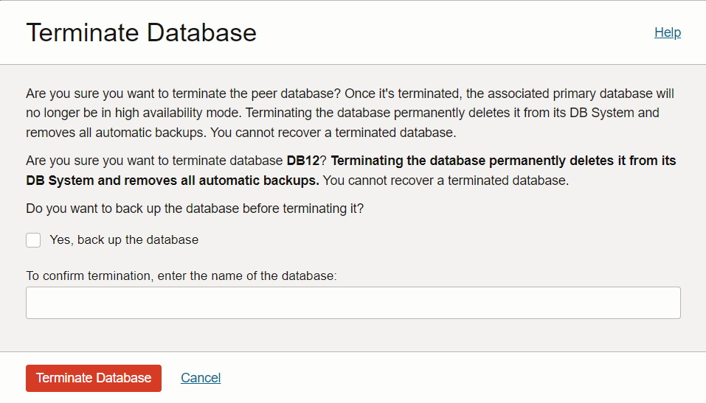
OCI Database Backup | Take Care before delete your Database

Slide 37
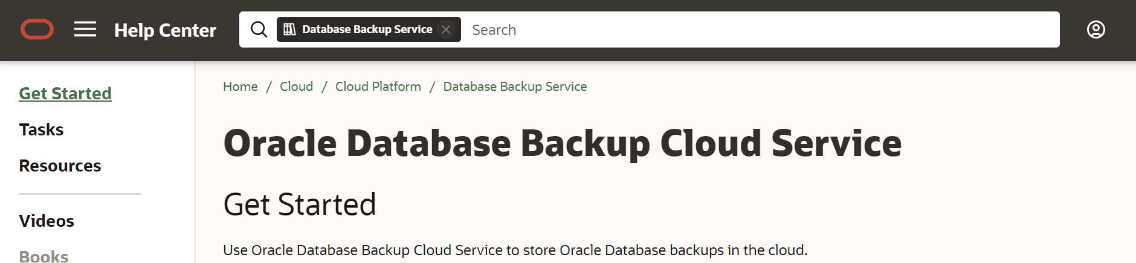
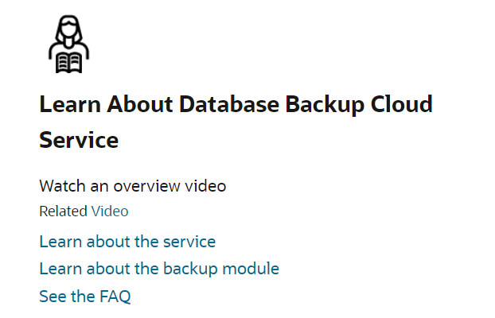
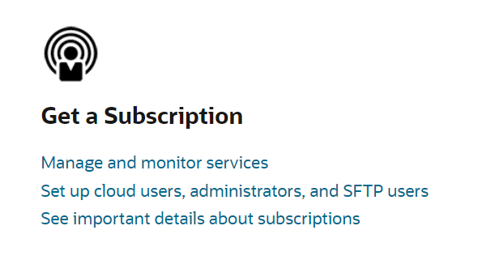
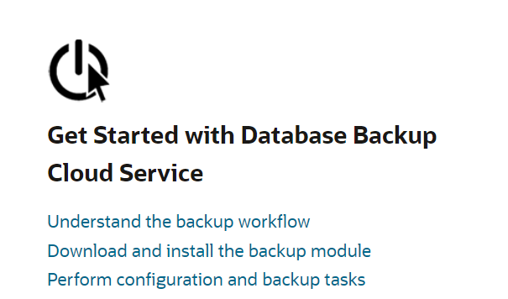
Cloud Backup | Oracle Database Backup Cloud Service page

Slide 38
Recovery Service offloads backup validation
All backups are checked for recoverability, reducing database service overhead
Traditional cloud backup
Backup (full or incremental) is created on the production database service and stored in object storage
Production service reads the backup from object store, validates it, and fixes issues doubling the impact on production database services
Periodic revalidation increases production database consumption
Resulting in:
Lower production performance if resource constrained, or
Higher consumption costs if resources are unconstrained, or
Decision to not validate backups or revalidate them, increasing risk
Production Database Service
1
2
3
Cloud
Storage
All work takes place on the production database service

Slide 39

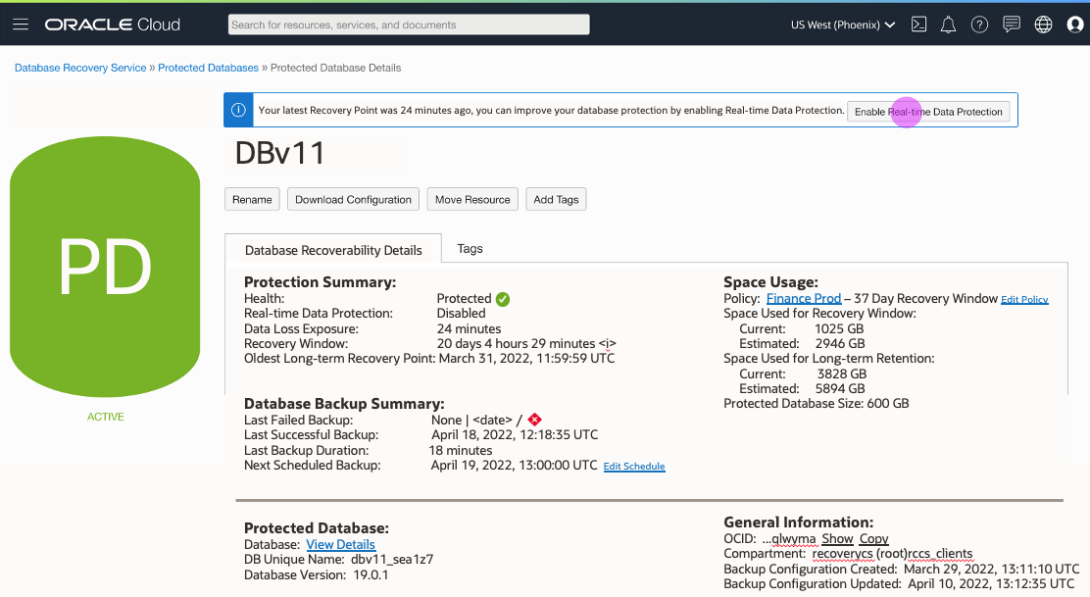
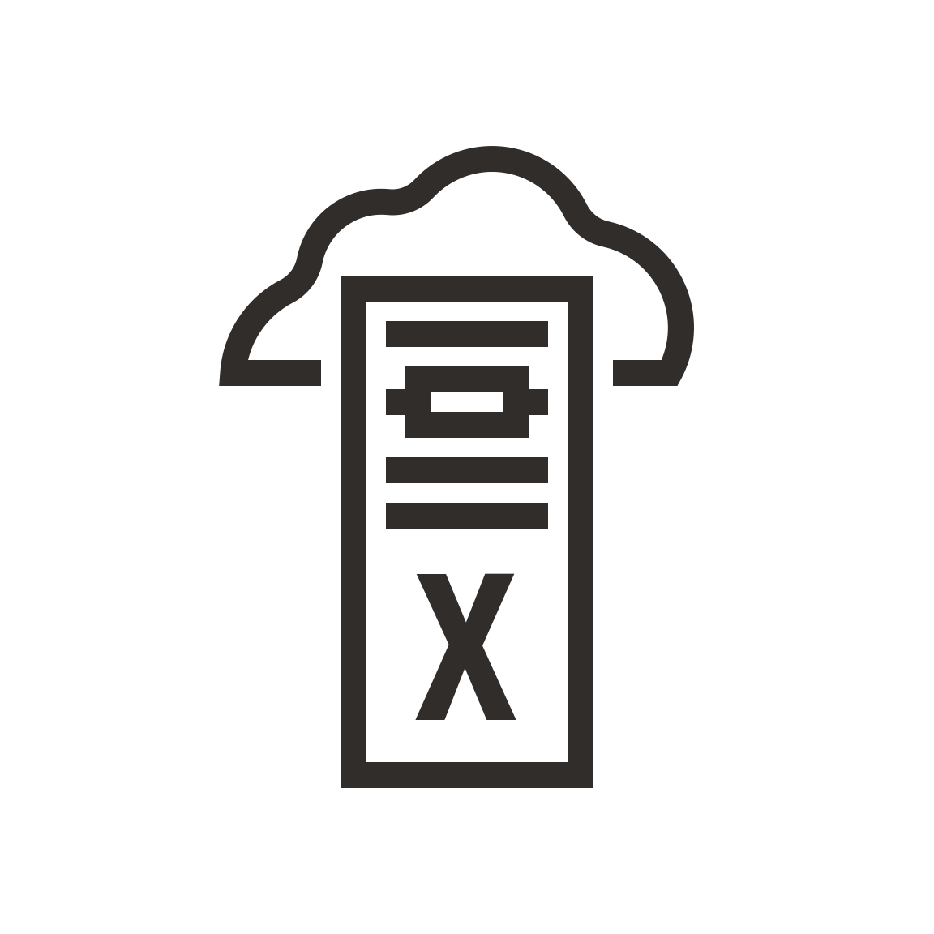
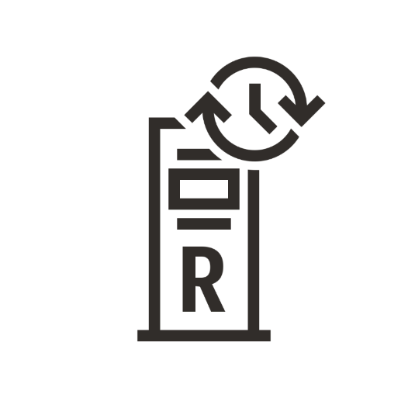




Oracle Database Zero Data Loss Autonomous Recovery Service
A fully managed, automated service for continuously protecting Oracle databases in OCI
OCI native administration
Ransomware resiliency
Automatic and mandatory encryption to help prevent data theft
Safeguards backups with enforced 14-day retention
Optimizes backups in the background for fast recovery with zero data loss
Operational efficiency
No more weekly full backups – eliminates production database overhead
Shorter backup windows with incremental forever strategy
Zero-impact database recovery validation for every backup
Cloud simplicity
Quickly configure database protection at scale with zero data loss
Control costs with database-specific backup consumption metrics
Gain deep data protection insights with granular recovery health dashboard
Using proven Recovery Appliance technology
Real-time data protection option
Exadata
Database Service
Zero Data Loss Autonomous
Recovery Service
Enterprise
Database Service
Automated
Compressed
Encrypted
Autonomous
Database
- Dedicated
Incremental
forever backup
Standard
Database Service
Encryption keys are owned by and managed with the database

Slide 40


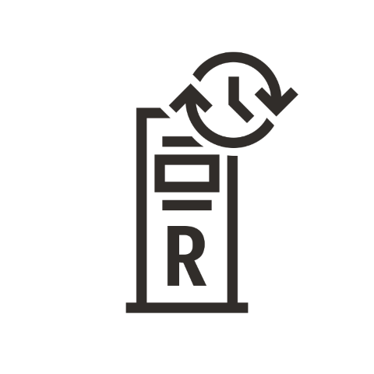
Recovery Service eliminates weekly full backups
Incremental-forever backups reduce backup overhead on production database services
Autonomous Database - Dedicated
Exadata Database Service
Day 0 Full
Day 1 Incr
Day N Incr
01001010110 10010101101
01001010010 10010101100
Enterprise Database Service
01001010110
01001010110
Time Machine
Standard Database Service
Incremental forever backups
of protected databases
Recovery Appliance Delta Push (What it Does)
Incremental forever backups
stored on Recovery Service

Slide 41
Recovery Service simplifies database restores
Creation of virtual full backups eliminates multiple incremental restore & apply cycles
Request: January 9, 2022
Day ‘N’ Virtual Full Backup
Restore Database To Day ‘N’ at 14:53.12
Autonomous Database - Dedicated
Exadata Database Service
Day 0 Full
Day 1 Incr
Day N Incr
Enterprise Database Service
Time Machine
Standard Database Service
Incremental forever backups
of protected databases
Recovery Appliance Delta Push (What it Does)
Incremental forever backups
stored on Recovery Service

Slide 42








Recovery Service continuously protects Oracle databases
Real-time protection of database changes increases resiliency with point-in-time recovery
Protected databases
Real-time logs
Purchase/Sale
Supply chain
Delivery
Payroll
HR update
Autonomous Database - Dedicated
Exadata Database Service
Day 0 Full
Day 1 Incr
Day N Incr
Enterprise Database Service
Time Machine
Standard Database Service
Incremental forever backups
of protected databases
Recovery Appliance Delta Push (What it Does)
Incremental forever backups
stored on Recovery Service

Slide 43
Recovery Service offloads backup validation
All backups are checked for recoverability, reducing database service overhead
Traditional cloud backup
Backup (full or incremental) is created on the production database service and stored in object storage
Production service reads the backup from object store, validates it, and fixes issues doubling the impact on production database services
Periodic revalidation increases production database consumption
Resulting in:
Lower production performance if resource constrained, or
Higher consumption costs if resources are unconstrained, or
Decision to not validate backups or revalidate them, increasing risk
Recovery Service backup
Incremental forever backup is created on the production database service and stored in the Recovery Service
The Recovery Service uses internal Oracle Database knowledge to check examine and fix backups when ingested, with no impact on production databases
The Recovery Service periodically revalidates backups with no production database consumption
Resulting in:
Minimal backup impact on
production databases
No additional production
database service costs
Higher recoverability & lower risk
Production Database Service
1
2
3
Recovery
Service
Most work takes place on the Recovery Service

Slide 44
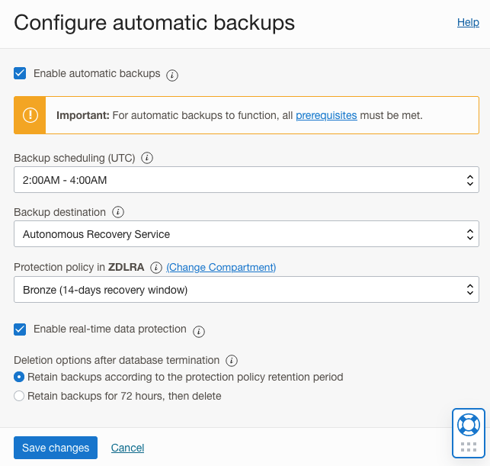
Recovery Service is easy to set up and use
Protect Oracle databases with less then 5 clicks in the OCI console
A fully managed OCI service with a simple UI
Enable automatic backups
Schedule daily incremental backups to meet your business schedule
Select Autonomous Recovery Service
Select protection window of 14 to 95 days
Enable real-time protection

Slide 45
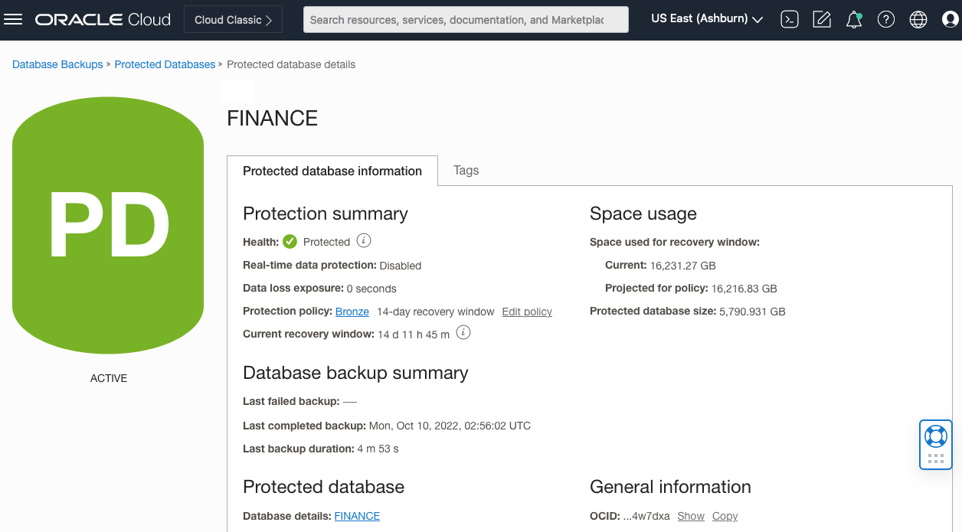
Recovery Service protects against unauthorized access
Built-in security and resiliency help safeguard mission-critical data
Encryption is mandatory
Non-encrypted databases are rejected
Keys are never stored in the Recovery Service
Access and management controls
No direct user access to storage – backup only
Access granted per protected database
14-day minimum retention enables recovery from human error or malicious internal actors
Resilient operations
Fault-tolerant across all infrastructure components
Highly available across Availability Domains and Fault Domain
Load balanced within a region

Slide 46
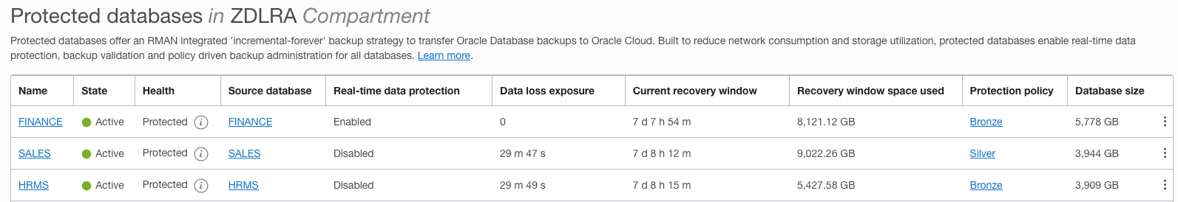
Recovery Service provides insights into backup health and operations
Built-in dashboards and tools simplify reporting and planning
Continuous monitoring of potential business risks
Data loss exposure
Recovery window
Critical data for operational planning
Capacity usage
Protection policy
Real-time protection and data loss exposure
Recovery window and capacity used
Protection policy

Slide 47
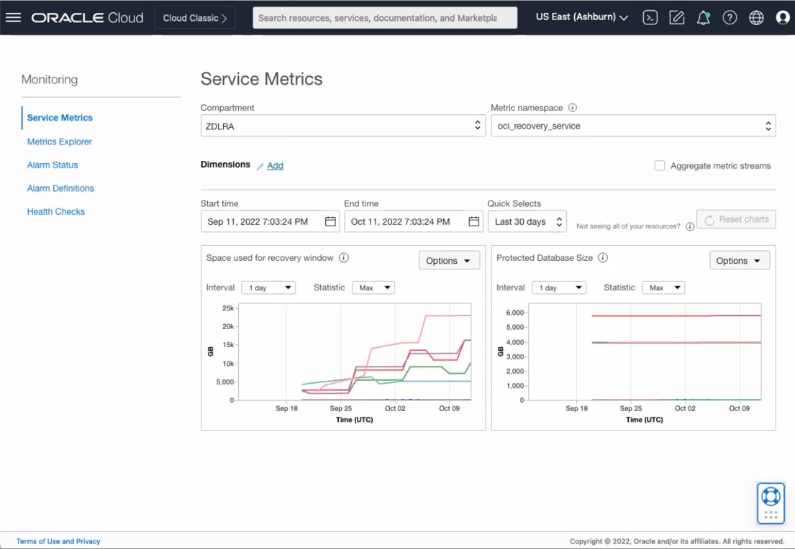
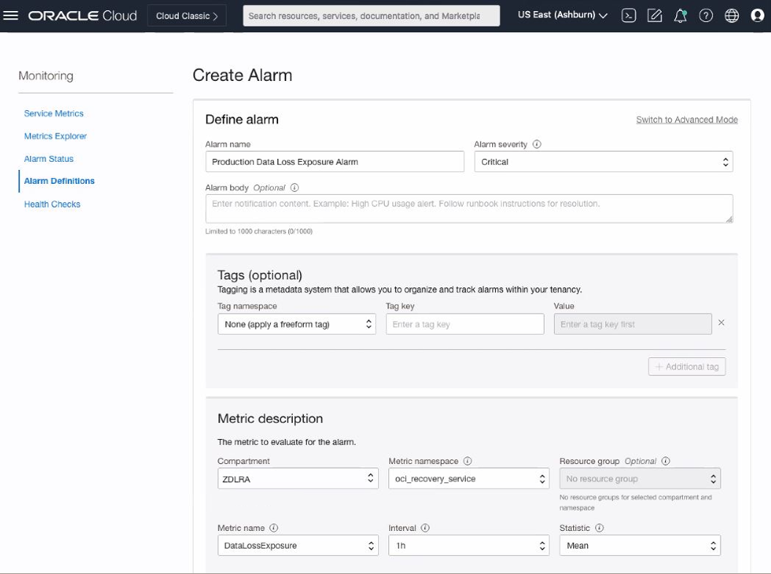
Recovery Service integrates with OCI observability and management
Comprehensive visibility across the full cloud stack
Integration with OCI Metrics Explorer provides common access to critical information
Alarms and notifications are created within OCI for consistent monitoring and management

Slide 48
Oracle NoSQL Database Cloud Service

Slide 49
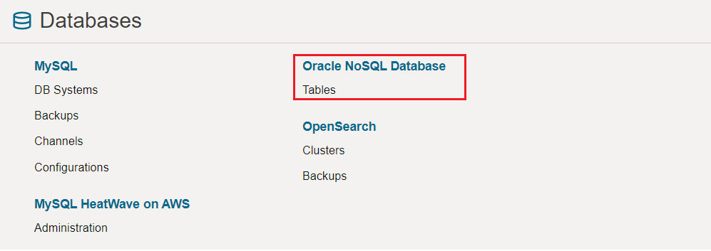
Oracle NoSQL Database Services on OCI Console
Easy provisioning and Management

Slide 50
Oracle NoSQL Database Architecture Overview
A distributed, shared nothing key/value data store architected for HA
Application
NoSQL Driver
Client
Key Space (Auto-sharded tables)
Server
Hash Function
Shard
Shard
Shard
Elected
Leader
Replica
Replica
Elected
Leader
Replica
Replica
Elected
Leader
Replica
Replica
Storage Node
Storage Node
Storage Node
Fault Containment Zone 1
Fault Containment Zone 2
Fault Containment Zone 3
Copyright © 2024, Oracle and/or its affiliates. All rights reserved

Slide 51
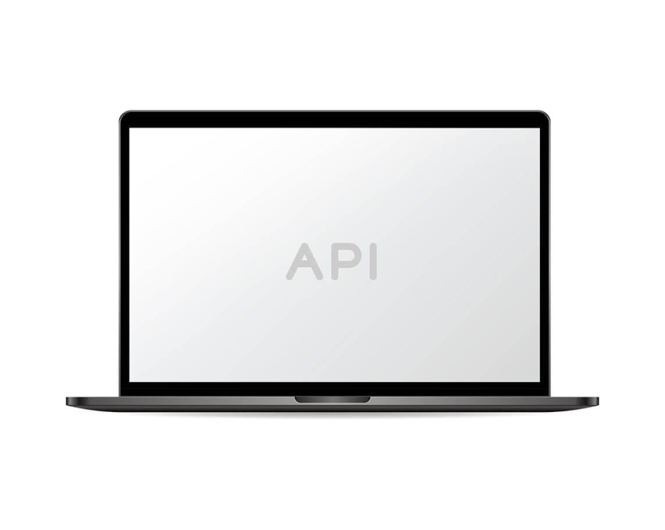
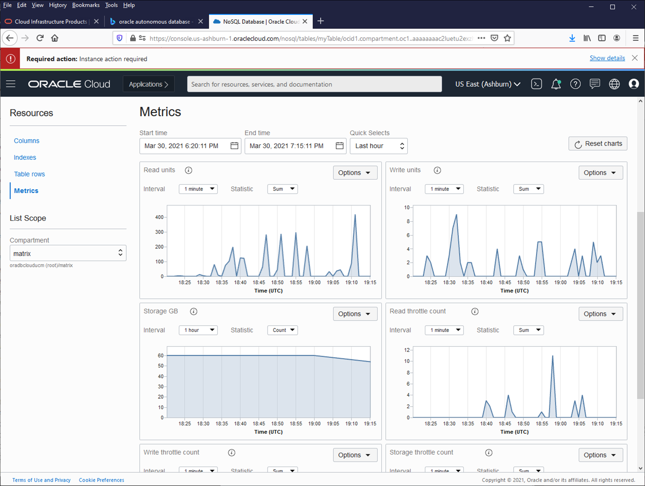
Oracle NoSQL Database Cloud Service
Built for extreme, dynamic workloads of today’s modern applications
Fast, Flexible NoSQL Database Service at any scale
Fully managed, serverless NoSQL database table service
Single digit millisecond and predictable latency at any scale
Linear throughput scaling for extreme workloads
Multi-model support (document, fixed schema, key/value)
Built-in high availability for business continuity
Fully ACID compliant and adjustable read consistency
Serverless computing through Oracle Functions
Available in 30 OCI commercial regions worldwide (Mar 2022)
Differentiated Use Cases
Request level granularity for extreme workloads, and handles spikes and drops optimally
Fast, constant, high-volume workloads requiring predictable low latency for highly responsive applications
Designed for business applications requiring scale, performance, and high availability with flexible consistency

Slide 52
Oracle NoSQL Database Cloud Service - Metrics
Throughput provisioning
1 Write Unit
1 Read Unit
The throughput of up to 1 kilobyte (KB) of data per second for a write operation over a one-month period
Approximately 2.67 million writes per month
The throughput of up to 1 kilobyte (KB) of data per second for an eventually consistent read operation
Approximately 2.67 million eventually consistent reads per month
2 Read units are needed for an absolute consistent read
METRIC:
Throughput of 1 KB /second
Period of a month
=3600 KB/Hr*744 Hr
=2.67 million (writes/reads) KBs
|1 KB|
. . .
. . .
. . .
|sec|
|sec|
. . .
. . .
|sec|
|sec|
|sec|
|sec|
|sec|
|sec|
|sec|
|sec|
|sec|
|sec|
|sec|
|sec|
|sec|
|
1 Month
|
Copyright © 2024, Oracle and/or its affiliates. All rights reserved

Slide 53
Oracle NoSQL Database Cloud Service – Capacity
Provisioned capacity vs. on-demand capacity
Provisioned Capacity
On-Demand Capacity
Must determine read/write units in advance
Adjustments done via API or console
Increasing unlimited
Decreases limited to 4 per day
Pay for what you provision
Deep understanding of workload needed
Automatic scaling
No rate limiting in your application
No workload characterization
Simple to use
Pay for what consumed
Copyright © 2024, Oracle and/or its affiliates. All rights reserved

Slide 54
Oracle NoSQL Database Cloud Service – Provisioned Capacity
Provisioned throughput
Provision reads/sec, writes/sec, GB storage at table creation time
Dynamically increase
Dynamically decrease
2000 read units
100 write units
500 GB Storage
JAVA code sample:
TableRequest tableRequest = new TableRequest() .setStatement(“create table if not exists foo (id integer, value JSON)”) .setTableLimits(new TableLimits(2000, 100, 500)) .setTimeout(1000); TableResult res = NoSQLHandle.tableRequest(tableRequest);
Modify the table lowering the read units to 1000
tableRequest.setTableLimits(new TableLimits(1000, 100, 500))
Note: Every TableRequest is a DDL call to the NoSQL store and may be performed 4 times within a minute.
Copyright © 2024 Oracle and/or its affiliates. All rights reserved

Slide 55
Oracle NoSQL Database Cloud Service – On-Demand Capacity
Auto-scaling throughput
Set to 0
Set to 0
500 GB Storage
On-demand mode
Python Code Sample
request=TableRequest().set_statement(statement).set_table_limits( TableLimits(0,0,500,TableLimits.CAPACITY_MODE.ON_DEMAND))
handle.do_table_request(request, 50000, 3000)
Copyright © 2024, Oracle and/or its affiliates. All rights reserved
Notes:
f

Slide 56

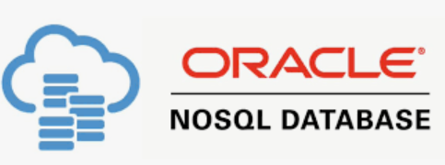
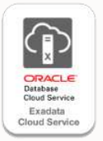
Demo 1 – OCI NoSQL Services
NoSQL Table provisioning
NoSQL Table Insert using OCI Console
Demo 2 – Exadata Smart Scan
Changing Table execution plan using Index
Change index to invisible and enable Smart Scan

Slide 57
Resources

Slide 58

Oracle Database Backup Cloud Services
https://docs.oracle.com/en/cloud/paas/db-backup-cloud/
Oracle NoSQL Database Cloud Service
https://docs.oracle.com/en/cloud/paas/nosql-cloud/
Exadata X9M Datasheet
https://www.oracle.com/a/ocom/docs/engineered-systems/exadata/exadata-cloud-infrastructure-x9m-ds.pdf
Exadata Cloud Dbaascli commande reference
https://docs.oracle.com/pt-br/iaas/exadata/doc/ecc-using-dbaascli.html
Exadata X10M Cloud at Customer Datasheet
https://www.oracle.com/a/ocom/docs/engineered-systems/exadata/exadb-cc-x10m-ds.pdf
Zero Data Loss Autonomous Recovery Service
https://www.oracle.com/database/zero-data-loss-autonomous-recovery-service
Notes:
Let us know how we can help you get the most out of your Oracle Databases.

Slide 59
Oracle oci License Management Services
https://www.oracle.com/corporate/license-management-services/
Exadata Cloud at Customer Documentation
https://docs.oracle.com/en/engineered-systems/exadata-cloud-at-customer/
Exadata Cloud Services documentation
https://docs.oracle.com/en-us/iaas/exadatacloud/exacs/exadata-cloud-infrastructure-overview.html
Exadata Cloud Dedicated on Azure
https://docs.oracle.com/en/solutions/deploy-exadata-on-oracle-db-azure/index.html#GUID-5EBF9A57-D710-48C4-BDDA-7E71A10AC62B
Oracle Live Labs
https://apexapps.oracle.com/pls/apex/r/dbpm/livelabs/home
Live Labs - Oracle NoSQL powers Video On-Demand applications
https://apexapps.oracle.com/pls/apex/f?p=133:180:17361911969675::::wid:3694

Slide 60
Live Labs - Discover Serverless Apps Using NoSQL Cloud Service
https://apexapps.oracle.com/pls/apex/r/dbpm/livelabs/view-workshop?wid=879&clear=RR,180&session=17361911969675
Live Labs - NoSQL Cloud Service
https://apexapps.oracle.com/pls/apex/f?p=133:180:17361911969675::::wid:642
Oracle NoSQL Database Cloud Service: Most flexible NoSQL Database
https://www.youtube.com/watch?v=TtZOy_NRouc

Slide 61
Thank you
Marcel Lamarca
marcel.lamarca@oracle.com

